Slide 1
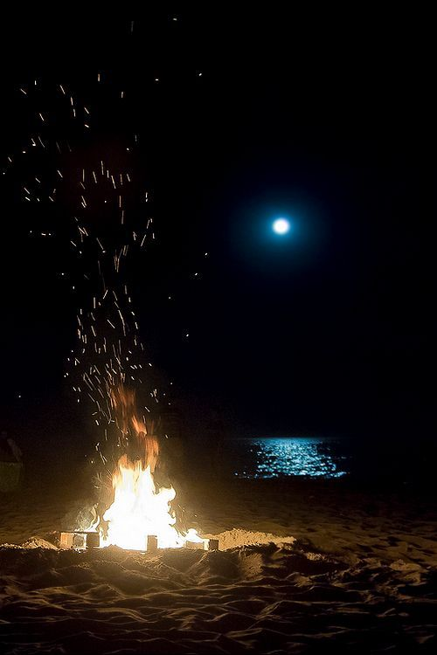

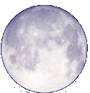

AROUND THE FIRE
OVER THE WATERS
AURORA
SHARING ARTS,
MUSIC AND CULTURE
FOR PEACE AND INCLUSION
2019-2021

Slide 2
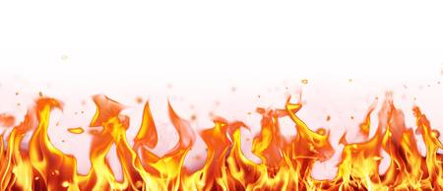
ACTIVITIES
A9 Quizzes about peculiarities and similarities of our partner mates.
AROUND THE FIRE
OVER THE WATERS
SHARING ARTS,
MUSIC AND CULTURE
FOR PEACE AND INCLUSION
2019-2021

Slide 3

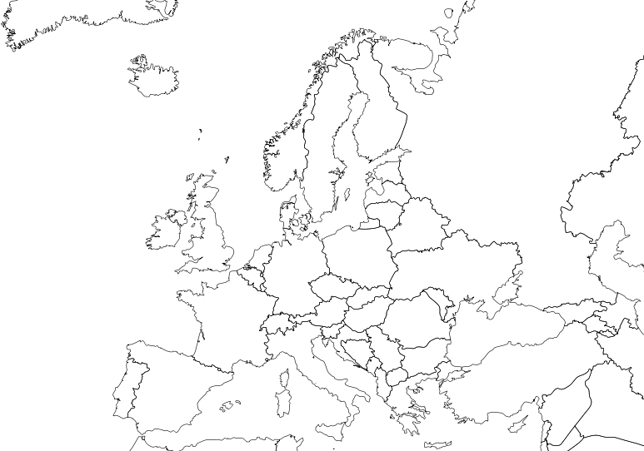
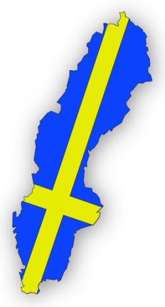

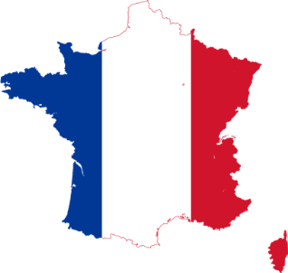
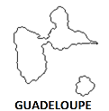

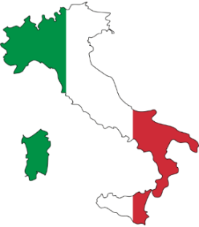

2019-2021
PROJECT REFERENCE No:
2019-1-FR01-KA229-062345_3

Slide 4


SHARING ARTS, MUSIC AND CULTURE FOR PEACE AND INCLUSION
PARTNER SCHOOLS
Collège Les Roches Gravées, Trois-Rivières, France;
Scoala Gimnaziala Magura, Buzau, Romania;
Gymnasium Panagias Theoskepastis, Paphos, Cyprus;
Istituto Comprensivo Monte Rosello Basso, Sassari, Italy;
Hakkasskolan, Hakkas, Sweden.

Slide 5
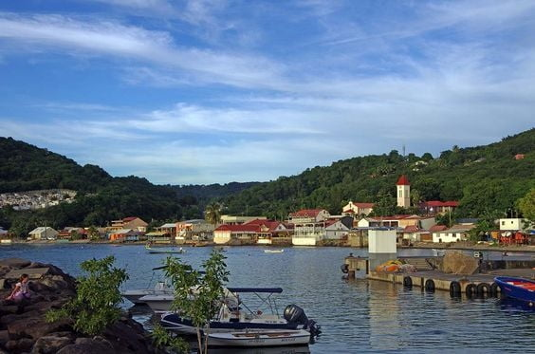
Which is the language spoken in Guadeloupe?
A: Italian
B:French
C:English

Slide 6
Go back to the question
Try again!
Go back to the question

Slide 7
CORRECT!
Go to next question

Slide 8
which partner countries in this project have the country's flag in three colors?
A: Cipru, Sweden, Romania
B: Italy, France, Sweden
C: Romania, Italy, France

Slide 9
Go back to the question
Try again!

Slide 10
CORRECT!
Go to next question

Slide 11
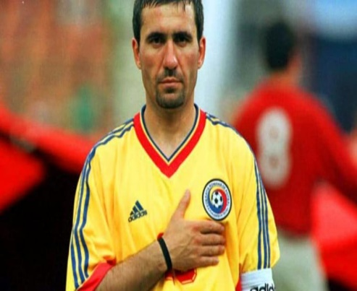
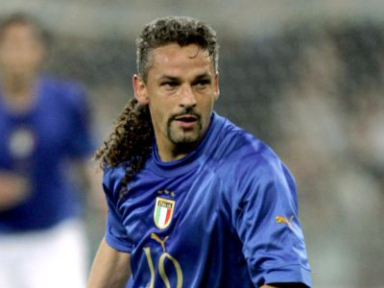
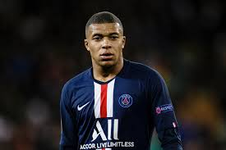
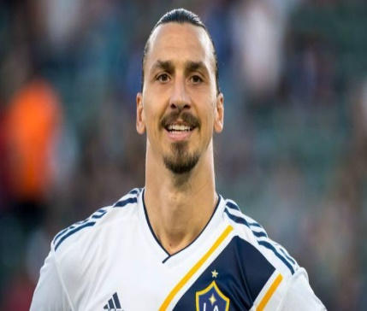
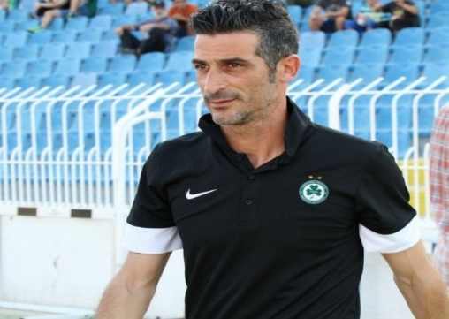
What do these people have in common?
A:Play polo
B:Play handball
C:Play football

Slide 12
Go back to the question
TRY AGAIN!

Slide 13
Go to the next Question
CORRECT!

Slide 14
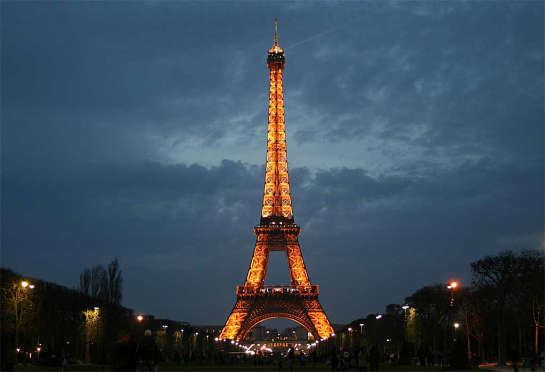
from which country is the image

Slide 15
ITALY
ROMANIA
SWEDEN
FRANCE
CYPRU

Slide 16
GO BACK TO THE QUESTION
TRY AGAYN!

Slide 17
GO TO THE NEXT QUESTION
CORRECT!

Slide 18
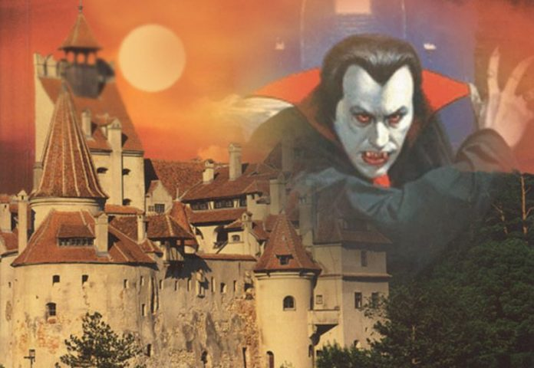
from which country is the image

Slide 19
ITALY
ROMANIA
SWEDEN
FRANCE
CYPRU

Slide 20
GO BACK TO THE QUESTION
TRY AGAYN!

Slide 21
GO TO THE NEXT QUESTION
CORRECT!
Next Slide

Slide 22
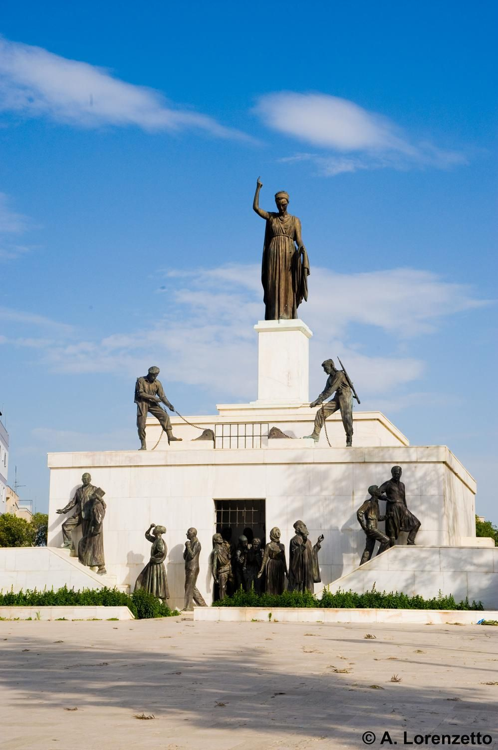
from which country is the image

Slide 23
ITALY
ROMANIA
SWEDEN
FRANCE
CYPRU

Slide 24
GO BACK TO THE QUESTION
TRY AGAYN!

Slide 25
GO TO THE NEXT QUESTION
CORRECT!

Slide 26
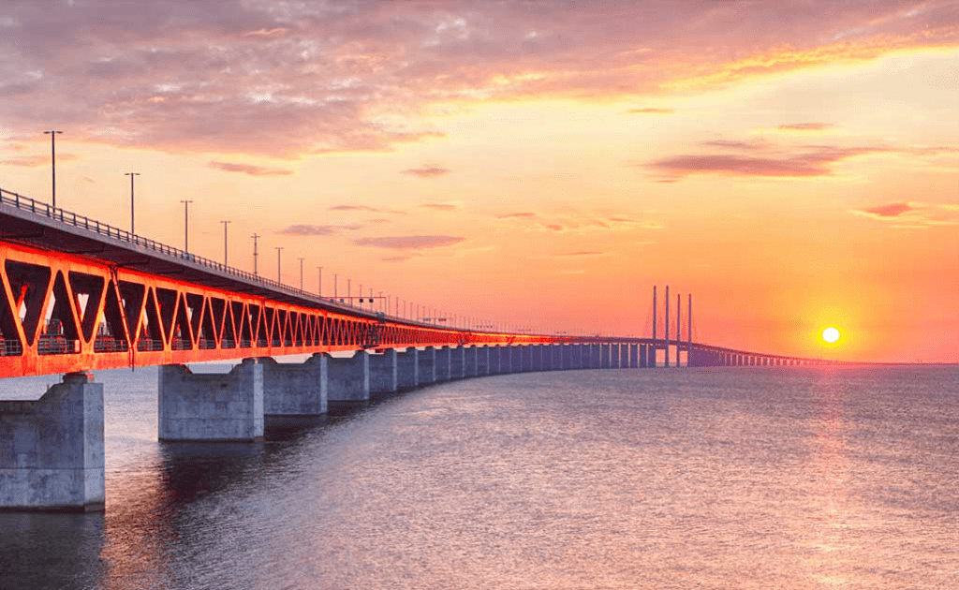
from which country is the image

Slide 27
ITALY
ROMANIA
SWEDEN
FRANCE
CYPRU

Slide 28
GO BACK TO THE QUESTION
TRY AGAYN!

Slide 29
GO TO THE NEXT QUESTION
CORRECT!

Slide 30
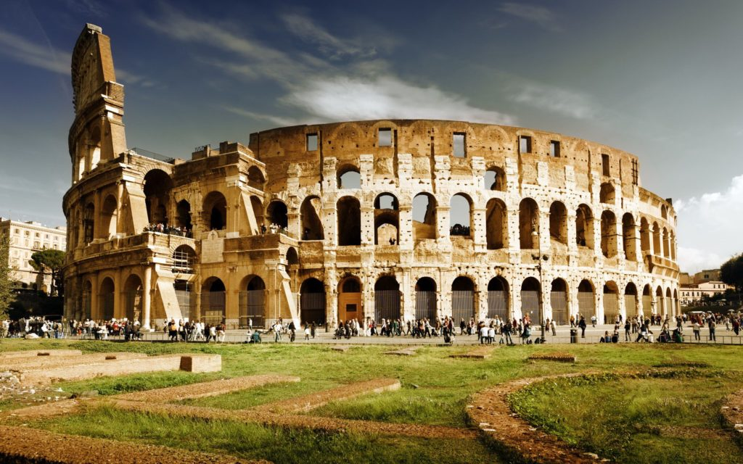
from which country is the image

Slide 31
SWEDEN
ROMANIA
ITALY
FRANCE
CYPRU

Slide 32
GO BACK TO THE QUESTION
TRY AGAYN!

Slide 33
GO TO THE NEXT QUESTION
CORRECT!

Slide 34



WHAT IS THE SIGN OF PEACE IN THE WORLD
A
C
B

Slide 35
A
B
C

Slide 36
GO BACK TO THE QUESTION
TRY AGAYN!

Slide 37
GO TO THE NEXT QUESTION
CORRECT!

Slide 38

YOU ARE AWESOME!

Slide 39
SHARING ARTS, MUSIC AND CULTURE FOR PEACE AND INCLUSION
ACTIVITIES
A9 Quizzes about peculiarities and similarities of our partner mates.

Slide 40

SHARING ARTS, MUSIC AND CULTURE FOR PEACE AND INCLUSION

